Slide 1

Health Wearable Device

Slide 2
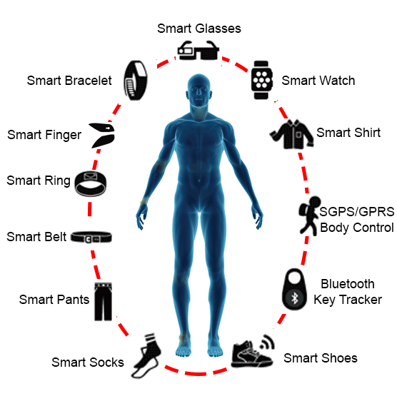
Introduction
Wearables becoming increasingly popular
Easy management of patient records
Quick medical response

Slide 3
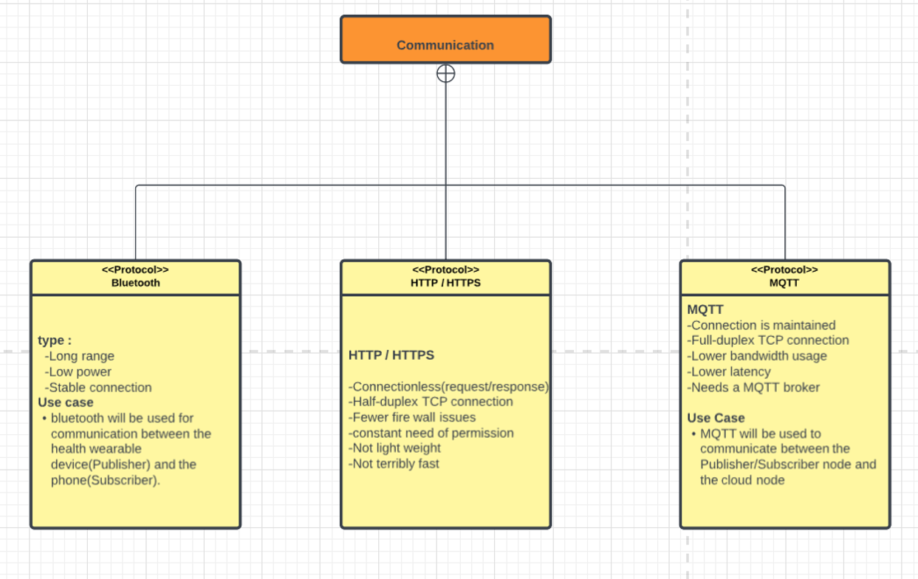

Slide 4
OVERVIEW OF OUR PROJECT
SENSOR NODE
[Publisher]
MOBILE DEVICE
[SUBSCRIBER/
PUBLISHER]
RASPBERRY PI
[MQTT BROKER]

Slide 5
User Interface
General information of the patient
Heart Rate
Body Temperature
Blood pressure

Slide 6
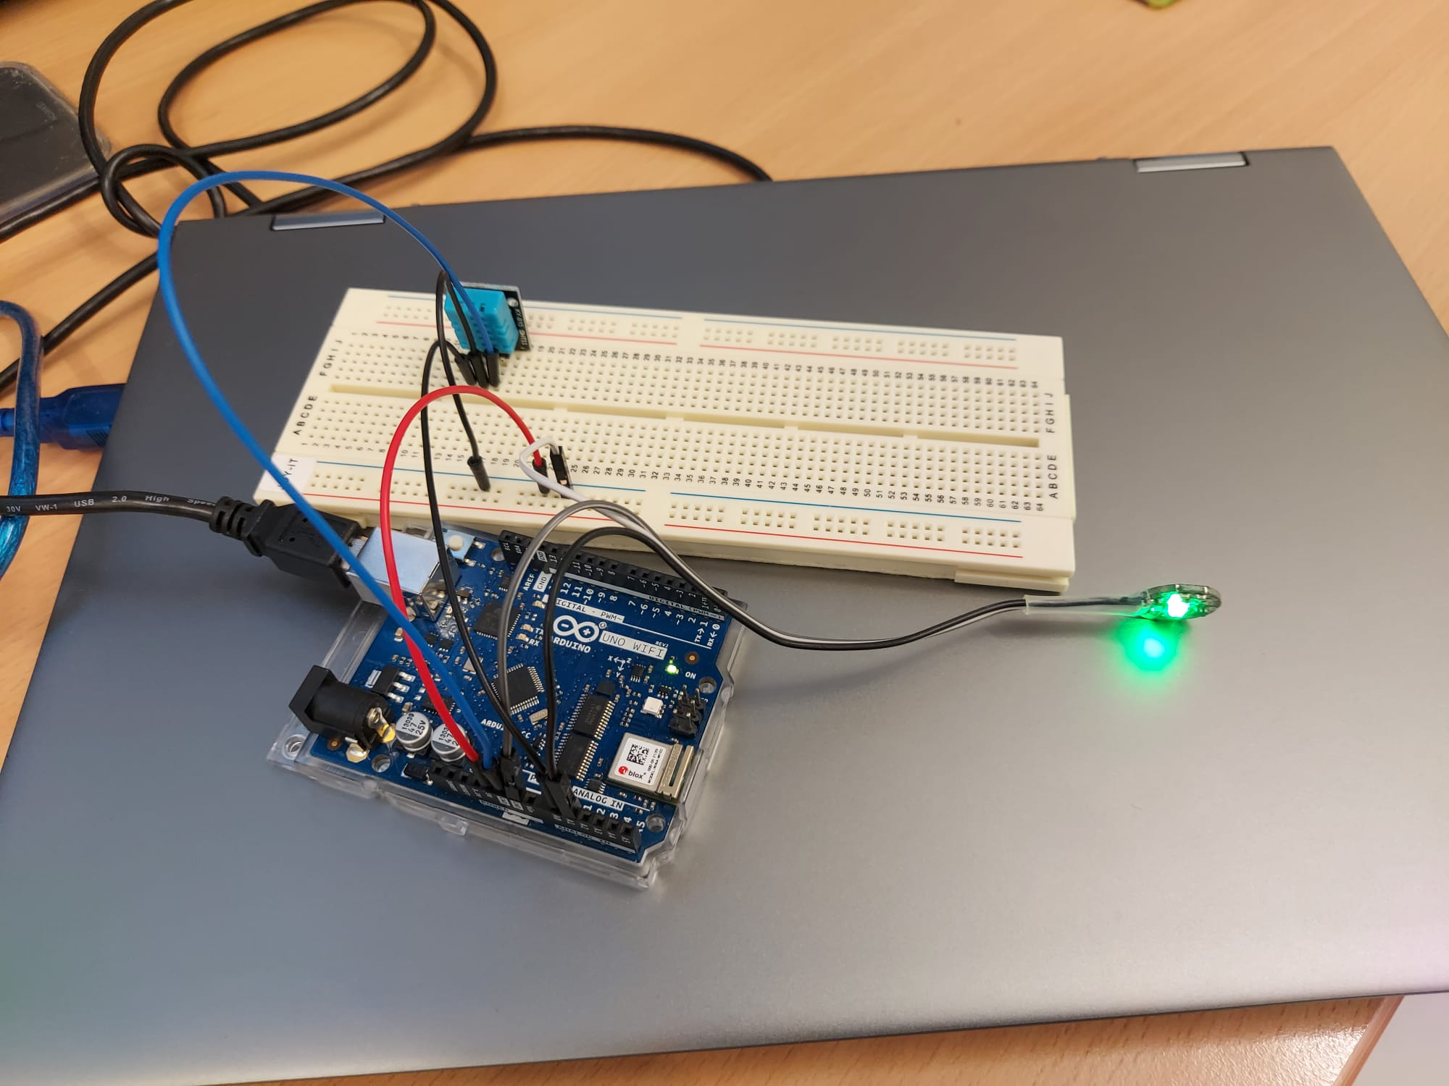
SENSOR NODE
[Publisher]

Slide 7
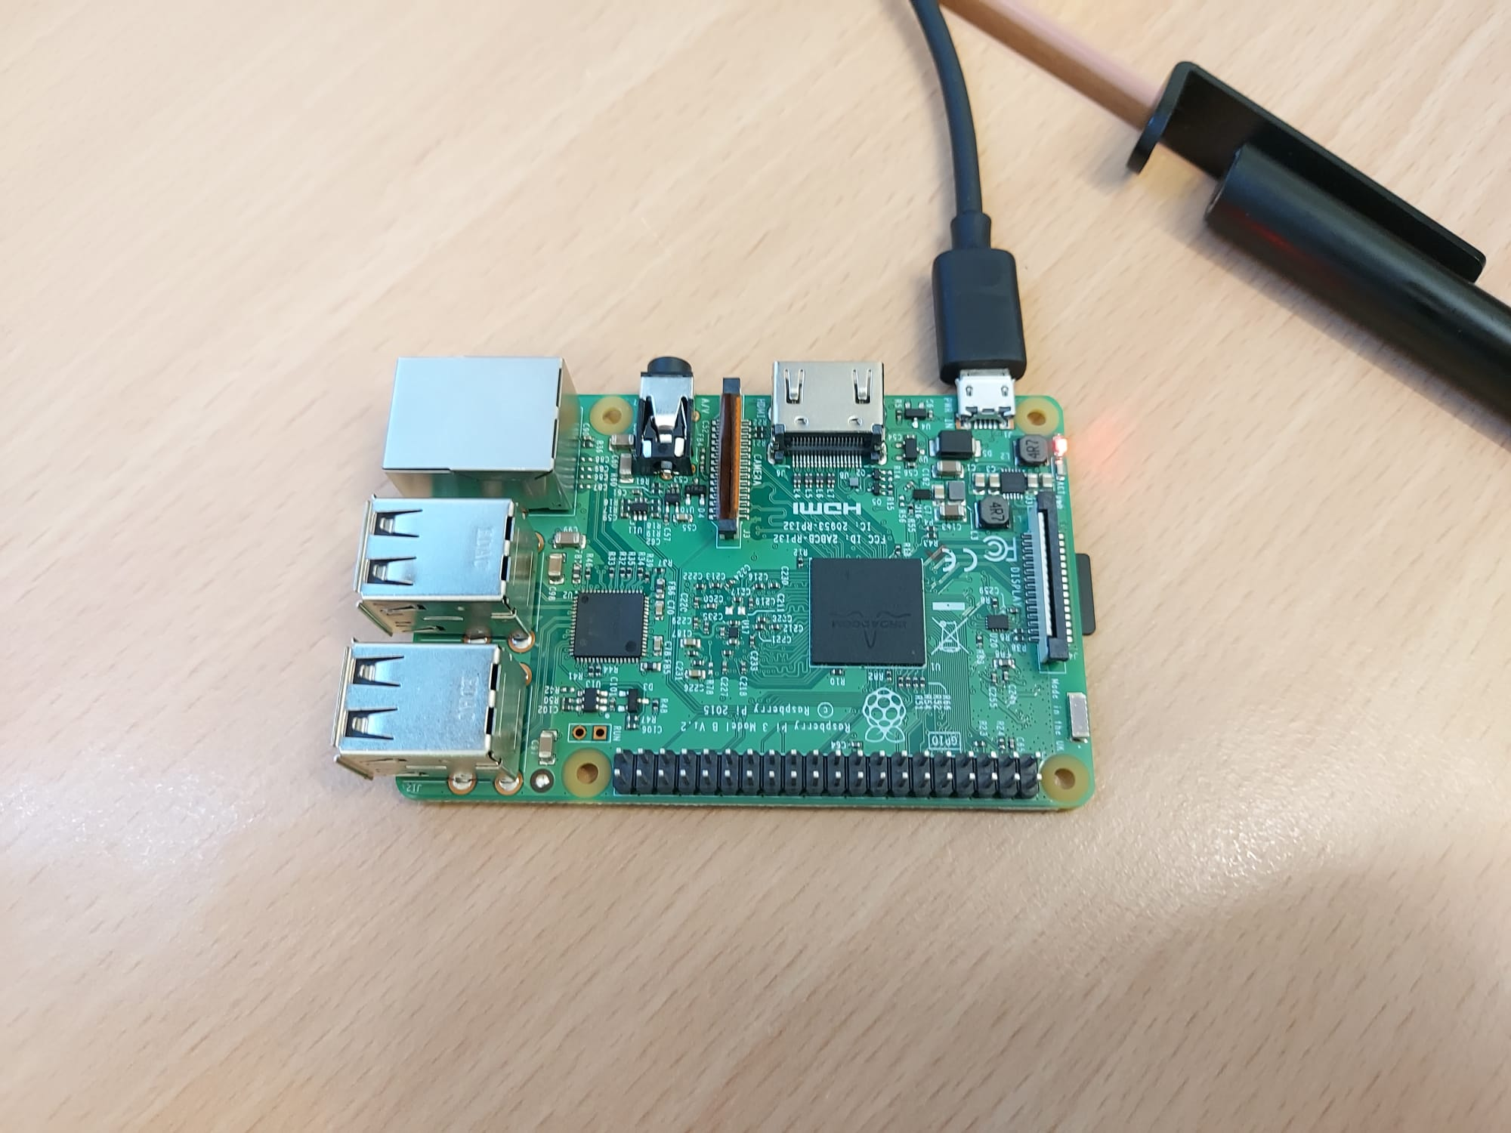
RASPBERRY PI
[MQTT BROKER]

Slide 8
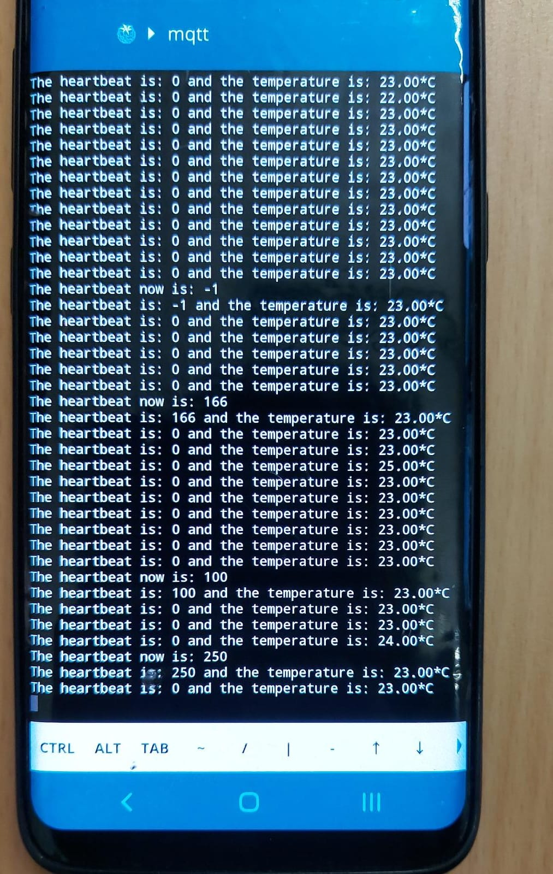
MOBILE DEVICE
[SUBSCRIBER/
PUBLISHER]

Slide 9
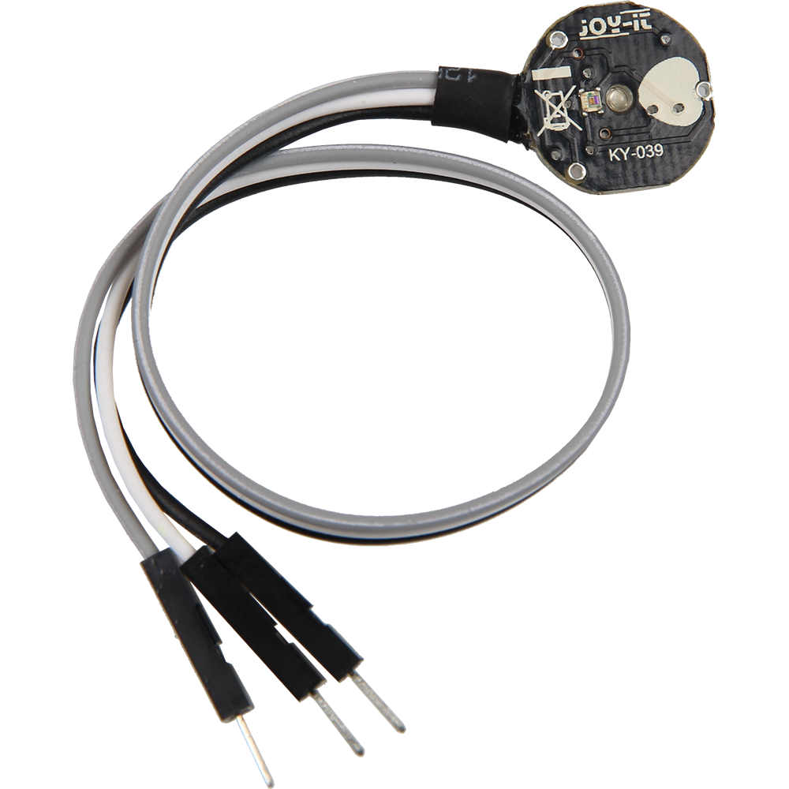
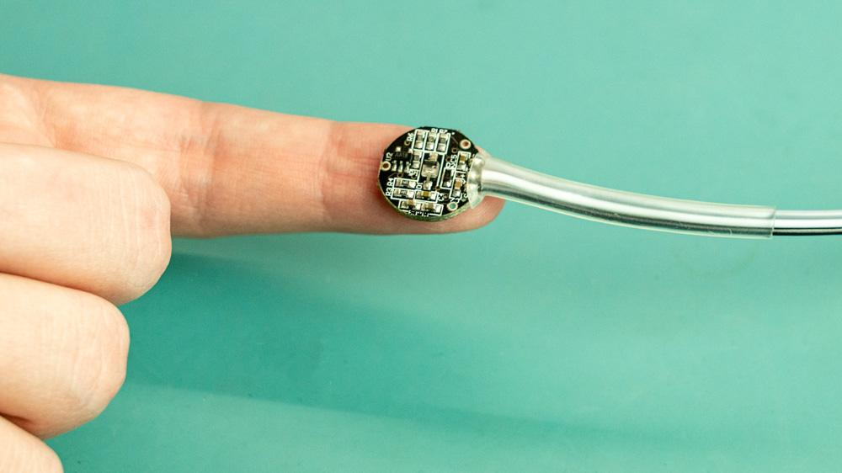
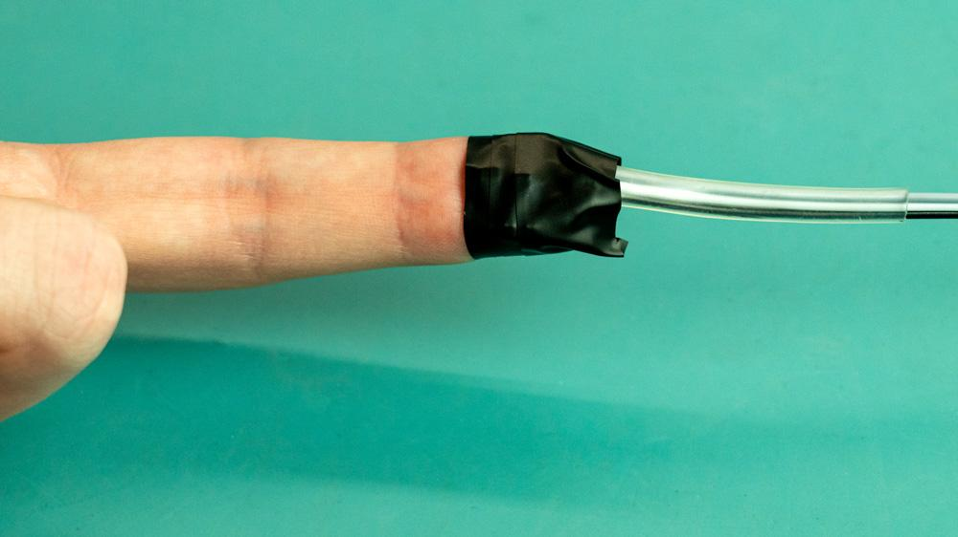
Heartbeat Sensor

Slide 10
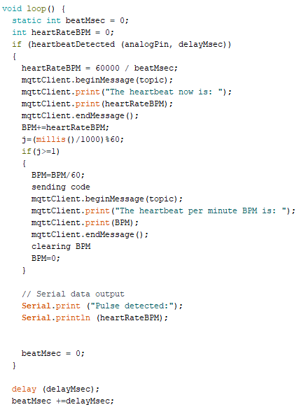
Heartbeat Sensor Code

Slide 11
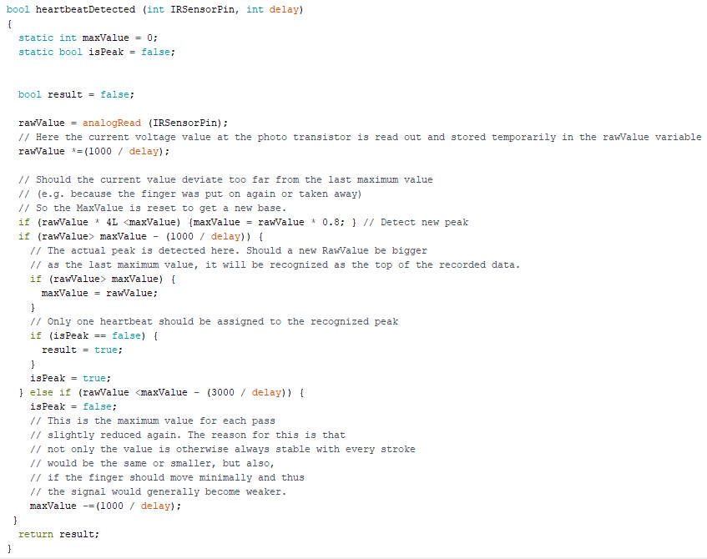
Heartbeat Sensor Code

Slide 12
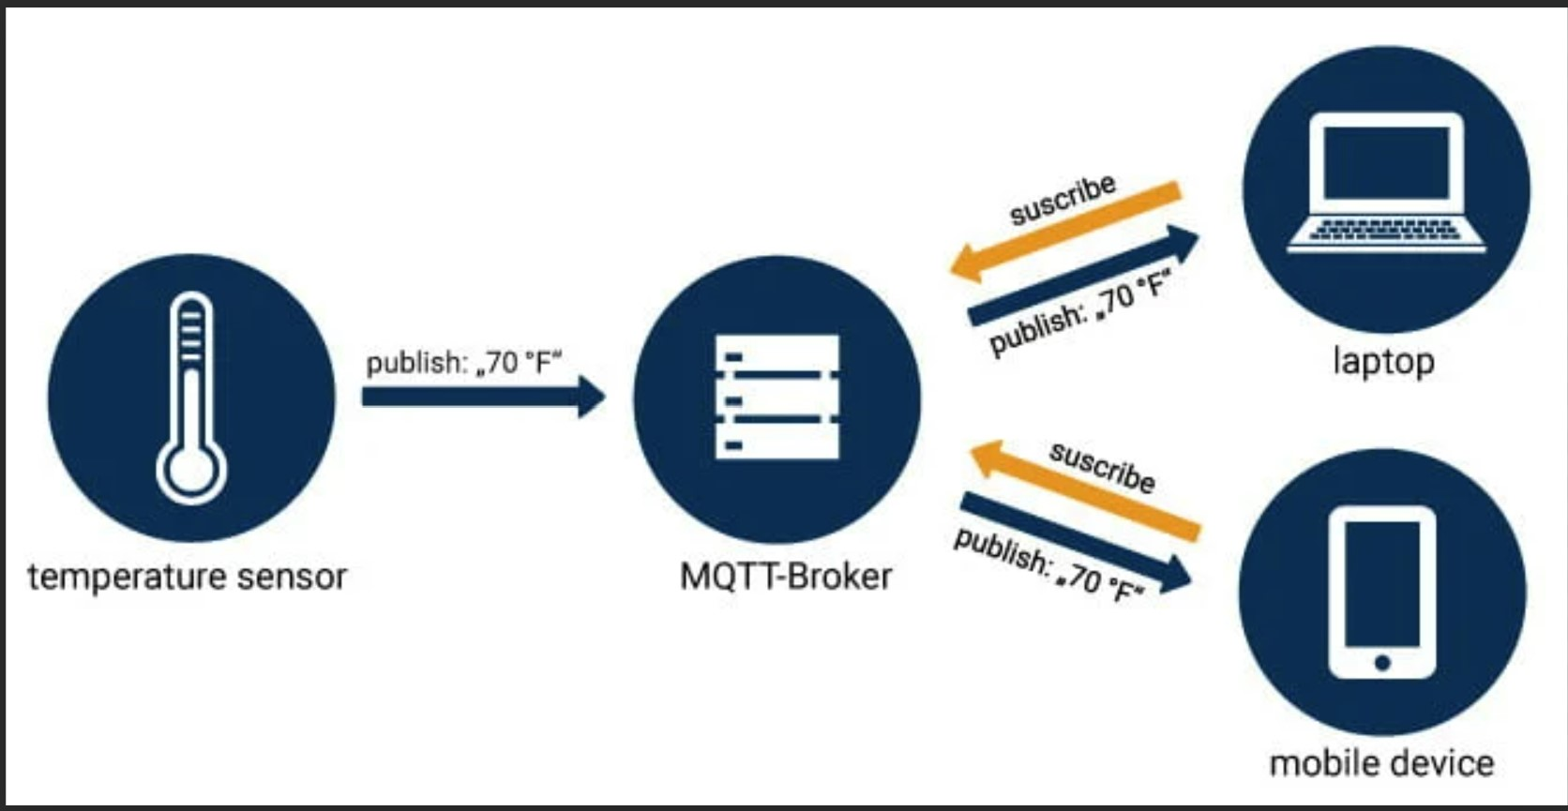
Heartbeat sensor

Slide 13
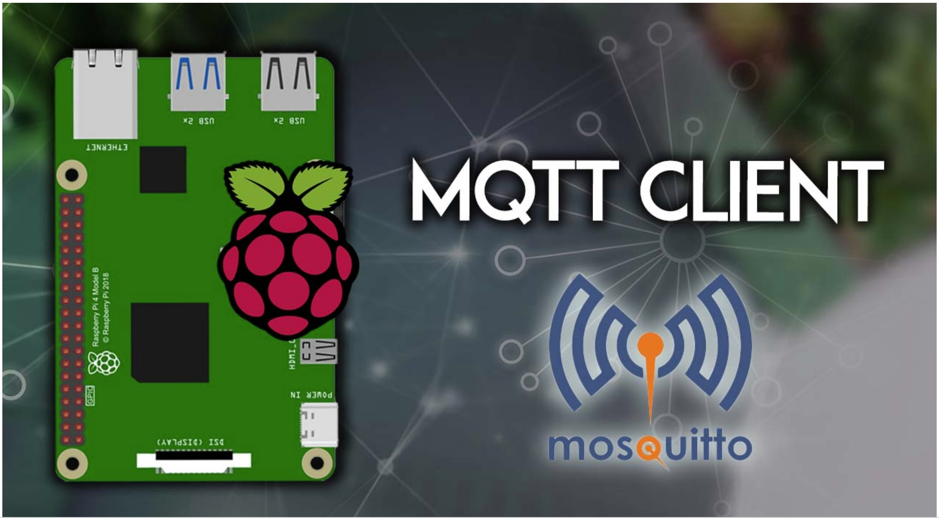
Raspberry as MQTT Broker
pi@raspberry:~ $ sudo apt install -y mosquitto mosquitto-clients
pi@raspberry:~ $ mosquitto -d

Slide 14
From broker(Publisher and Subscriber)
mosquitto -d
mosquitto_pub -d -t testTopic -m
Mosquitto_sub -d -t testTopic -m

Slide 15
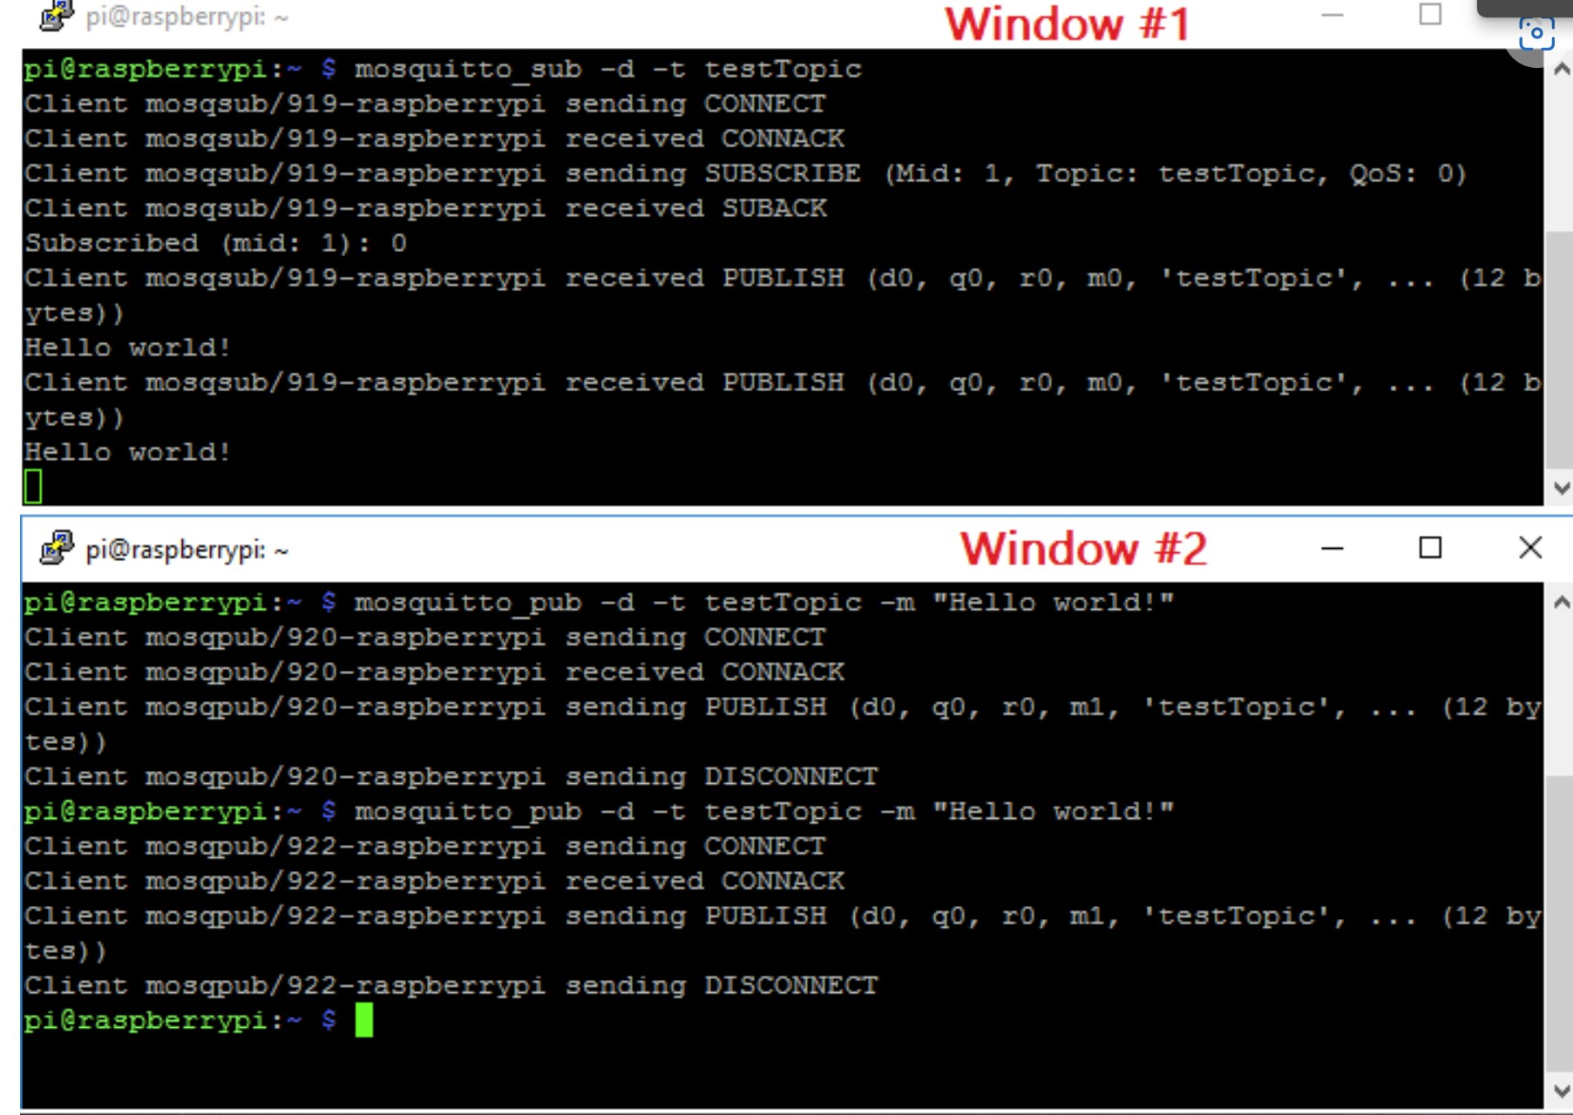
Raspberry to Laptop as client

Slide 16
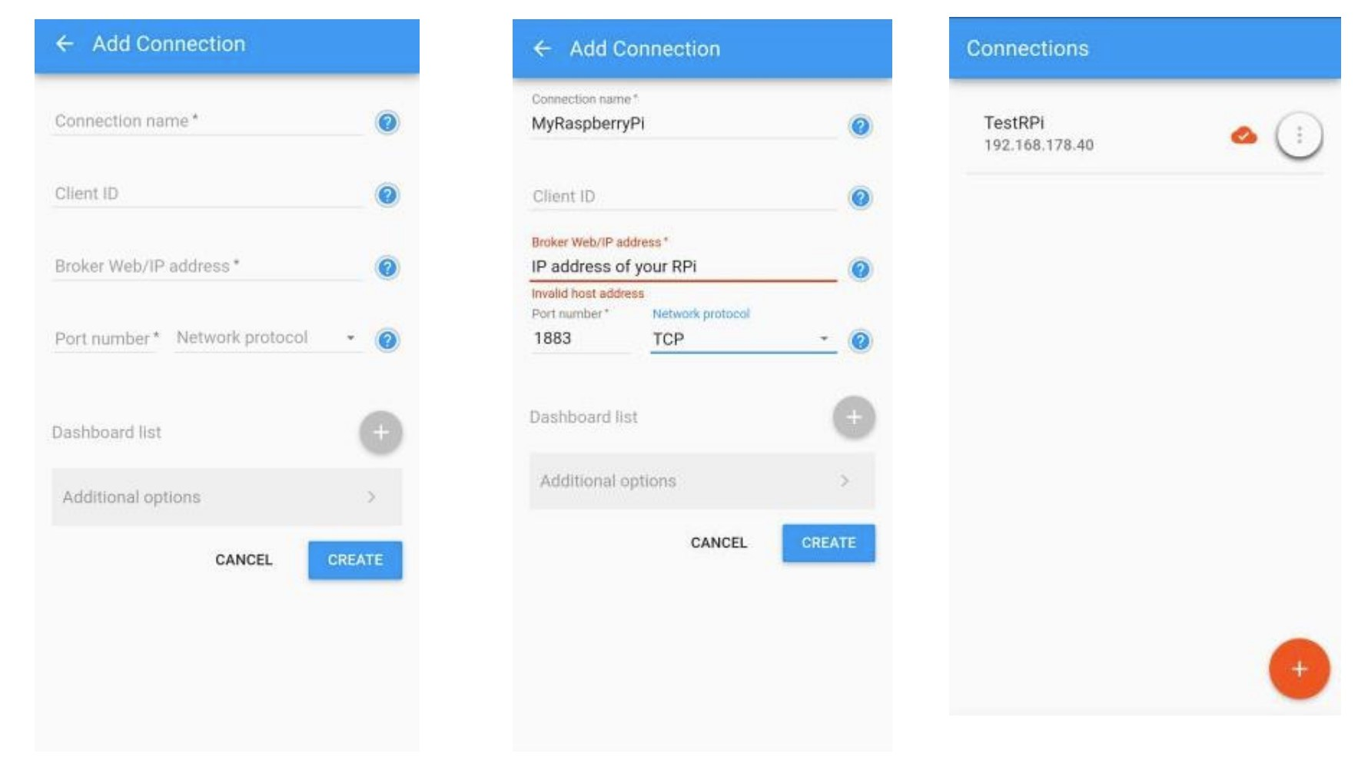
Smartphone as client

Slide 17
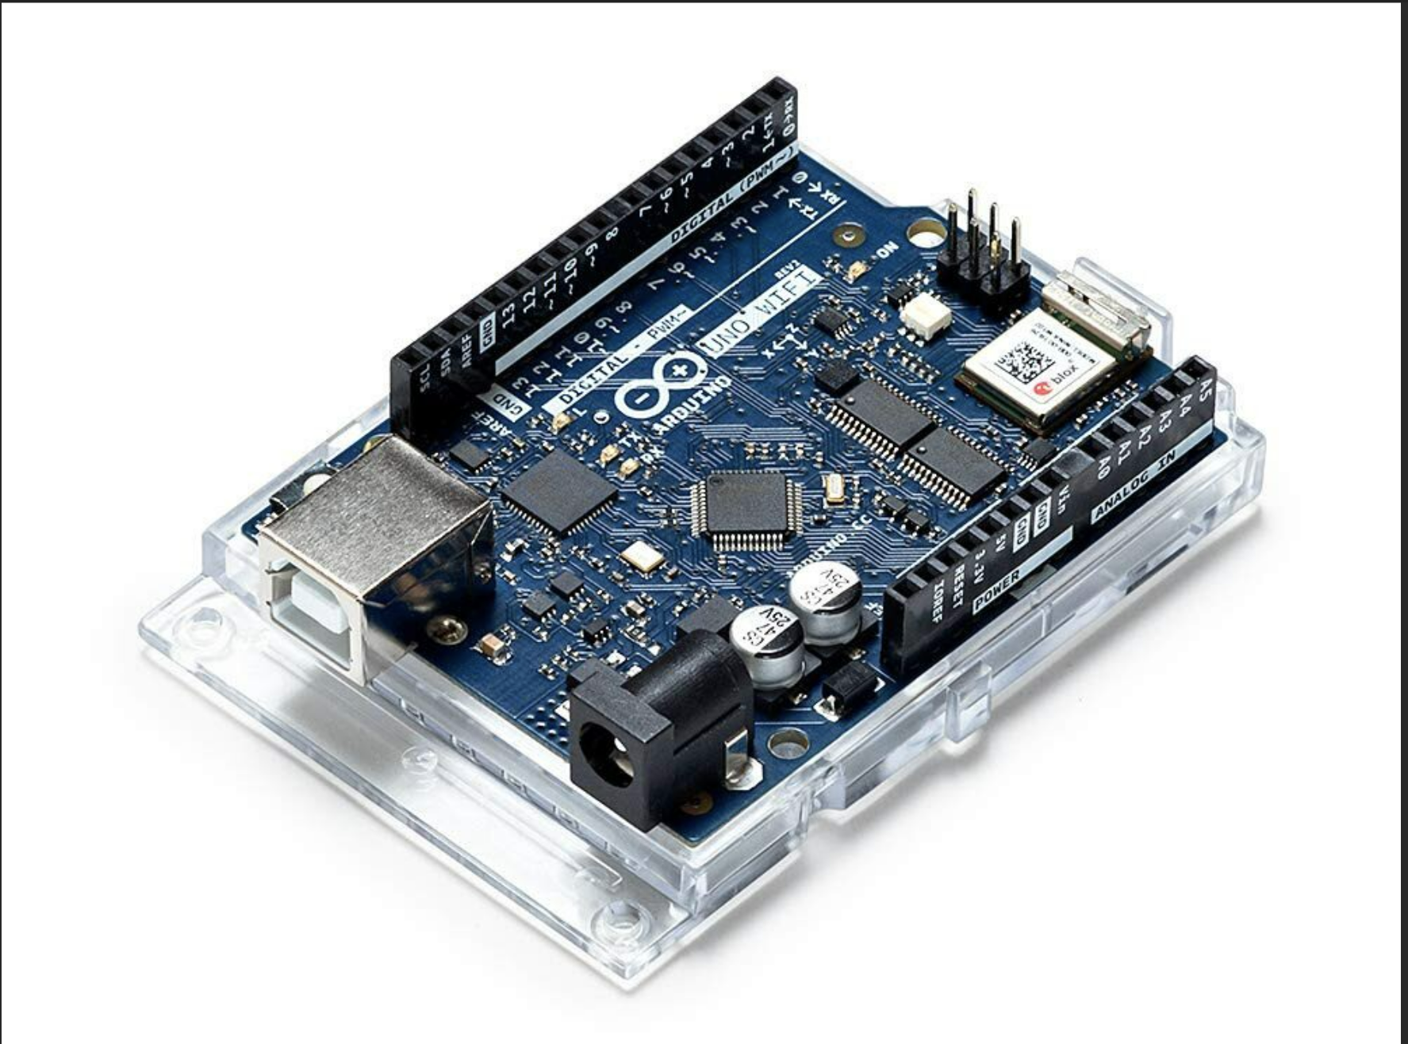
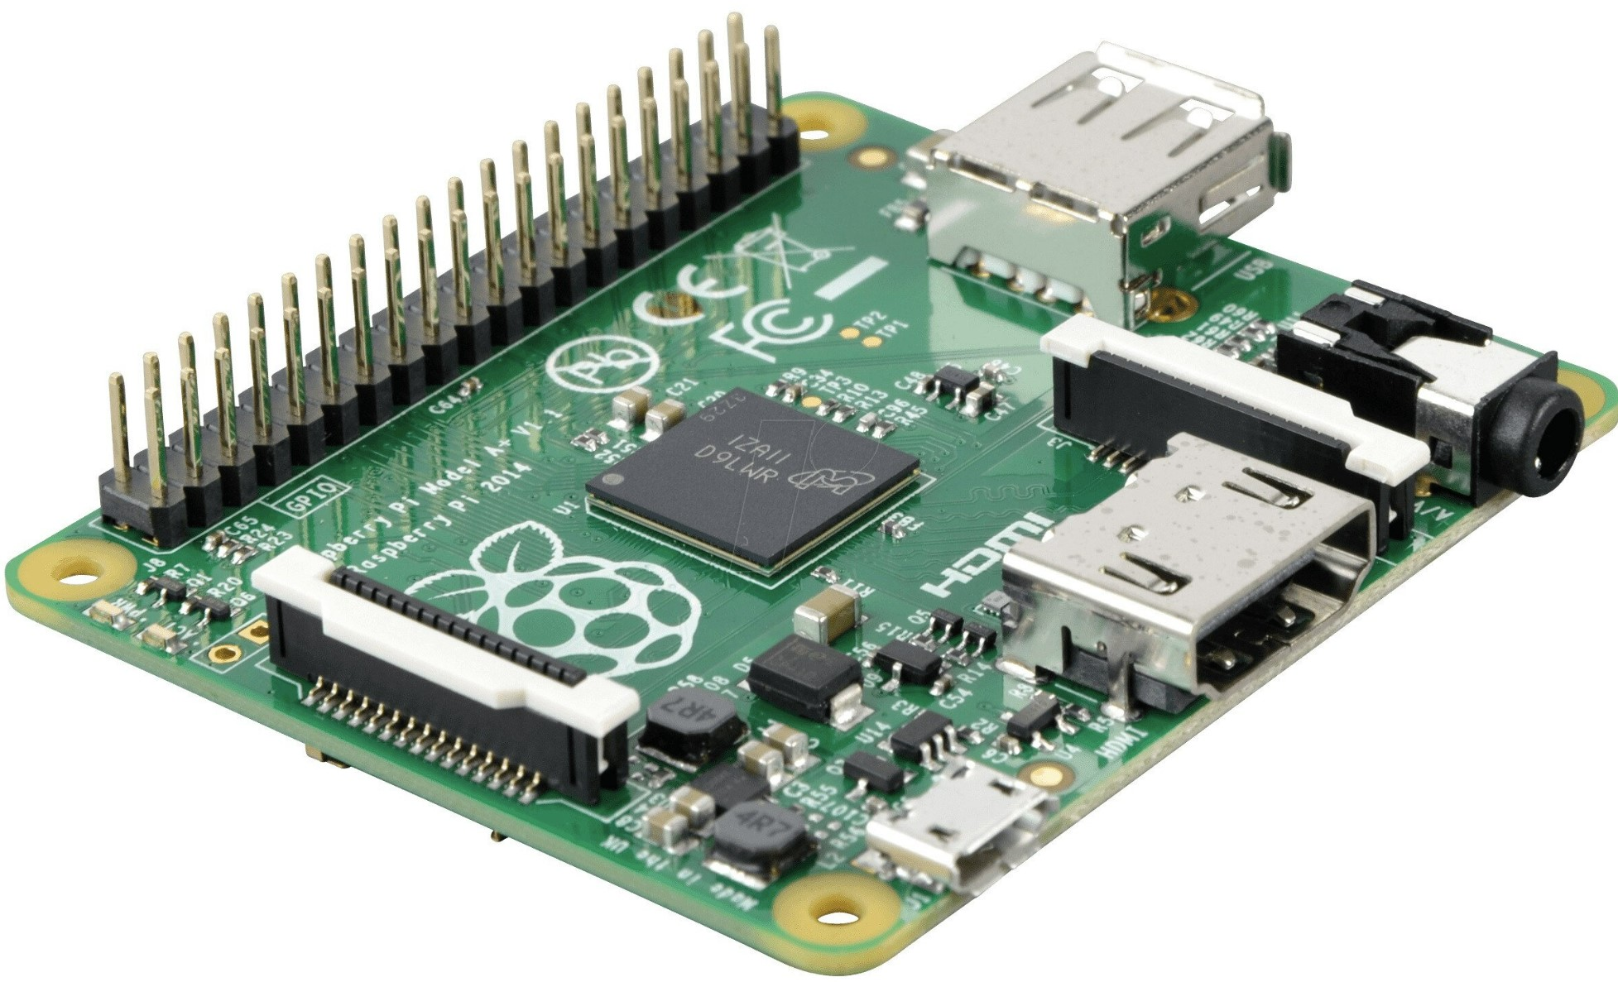
MQTT Broker to Arduino

Slide 18
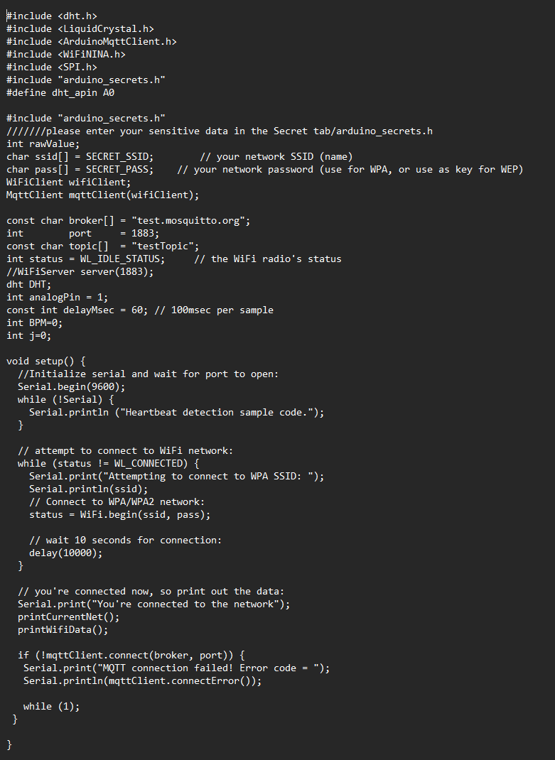
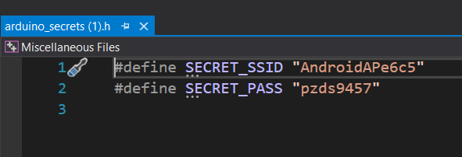
The code for transmitting the data

Slide 19
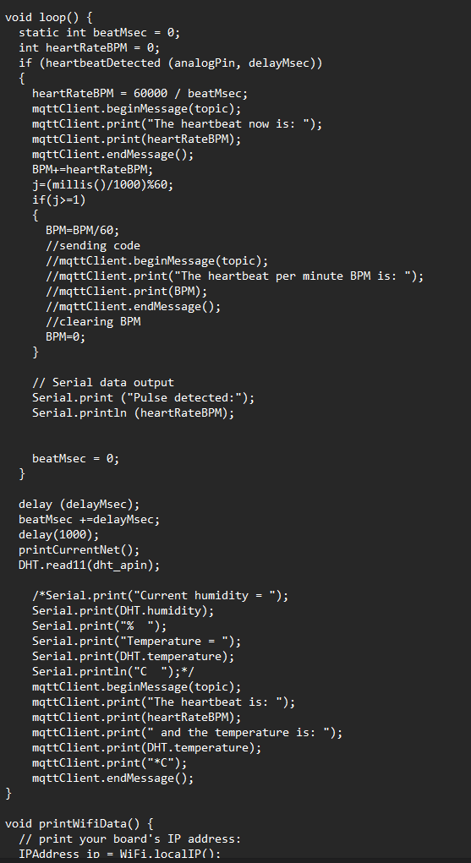
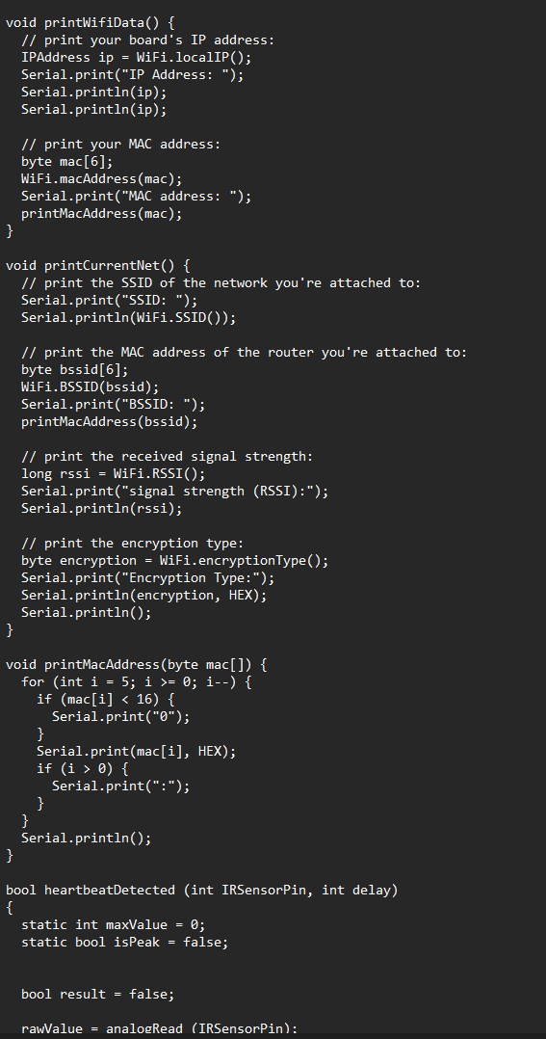

Slide 20
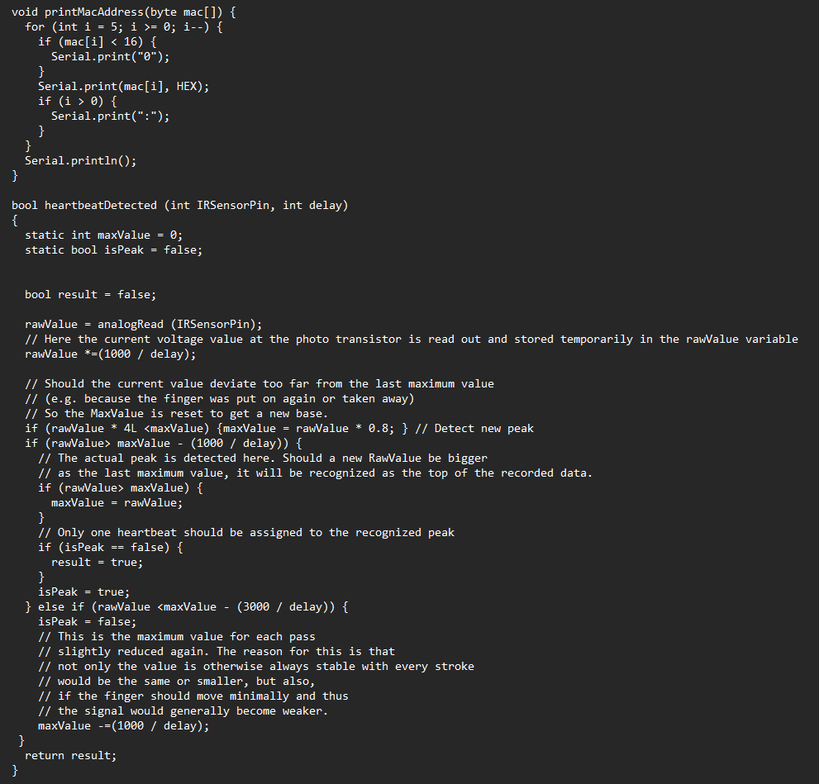

Slide 21
Reference images
https://www.researchgate.net/figure/Different-types-of-wearable-technology_fig5_322261039
https://www.designnews.com/sites/designnews.com/files/W6XXNX.jpg
https://www.allheart.com/b-sphygmomanometers.html
https://hbr.org/resources/images/article_assets/2019/05/May19_26_647373390.jpg
https://content.u-blox.com/sites/default/files/Solution-architecture-for-portable-and-wearable-health-devices.jpg
https://sensorkit.joy-it.net/en/sensors/ky-039

Slide 22
Questions

